Slide 1
AI Model for Optimizing Potato Trait Combinations in Future Breeding and Cultivation Amid Climate Change and Disease Challenges
By Shadrack Odikara¹ and Meshack Emakunat²
Henry Juarez³ Israel Navarrete³ Kante Moctar³
1. Kenya Agricultural and Livestock Research Organization (KALRO)
(Bioinformatics Scientist)
2. University of Nairobi Department of Agricultural Economics (UoN)
(Agronomist and a Post graduate studying Agriculture Information Systems)
3. International Potato Center (CIP)
(Our Mentors)

Slide 2
Introduction
Challenges to do with climate change and the varying potato disease severely impact and treaten production to satisfy growing global demography.
Under resource contrains many researcher and farmers alike would like to know the the potato variety to cultivate at a particular season given the risk of disease spread in their region.
The breeder may want to know which trait will be the most ideal to breed for or against given the future social preferences, climate and disease risks prevalences
Most likely these senarios will be under a resource poor setting (remote fields).
Address challenges in potato cultivation caused by climate change and emerging plant diseases.

Slide 3
Introduction
Here we train an large language model based on decoder only model on all available knowledge on potatoes and link it to an epidemiological realtime model of cropland connectivity.
To predict optimal trait combination for cultivation amid climate change and disease prevalences and subsequently develop a predictive model entailing the future social demographic changes towards potatoes based of SDG impacts

Slide 4
Problem statements
Currently we faces an ongoing struggle against pathogens, as novel ones continually emerge and re-emerge across various ecological zones.
Climate change modifies the dynamics of host-pathogen interactions, thereby facilitating the proliferation of pathogens in increasingly suitable environments.
As the worlds demography increases the more and more we will keep strungling to feed the growing populations in the future.
Alot of actiion is being taken to arrest these situation and make the world to be food secure.

Slide 5
Objectives
We set out an objective to develop a predictive model for future optimal trait combinations given disease spread and changing climatic conditions
Specifically we set out to:
- Develop and simulate and epidemiologic potatoe disease spread using future climate conditions and cropland connectivity
- Develop a predictive model entailing the future social demographic changes based of SDG impacts
- Develop and ensemble predictive model for future breeding needs for potatoes and the best trait combinations

Slide 6
Data Sources and Methodology
Data Sources:
Curated data on potato traits, genetic markers, socio-economic dynamics, and climate.
Sources: CIP reports, Agricrops databases, Wageningen University, openweatherData.org.
instructions | premise | hypothesis | label
A description of a potato variety Accent including its market and agronomic traits relative to its disease resistances | There is a potato variety called Accent Accent is a high yielding early bulking table variety. Attractive, uniform oval tubers with light yellow skins and flesh and excellent cooking characteristics. Resistance to common scab, bruising and splitting. Resistant to potato cyst nematode Globodera rostochiensisi Ro1. Susceptible to foliage and tuber late blight, blackleg and potato cyst nematode Globodera pallida Pa 2/3 and 1. Sensitive to Sencorex post emergence. this variety is as a result of a genetic cross between Alcmaria and AM66.42 and it was developed in Netherlands . This variety was bred at approximately the year undetermined . The shape of this variety is Short - oval and the colour of the skin is Cream . The colour of its flesh is Light yellow and the depth of its eye is Shallow - medium . The smoothness of its skin is Medium while the colour of its base lightsprout is Pink . It is a First Early maturing variety with a Short height while the flower colour is White as its frequency of berries is Absent . On a scale of 1 to 9 its reaction to various diseases and disorders are as follows with 1 to 3 being resistant and 4 to 6 being tolerant and 7 to 9 being susceptible to bruising is 8 , to splitting is 7 , to Potato Virus YO is 4 , to Potato Virus YN is unknown , to Potato Virus A is unknown , to Potato mop top (spraing) is unknown , to Potato Leafroll Virus is 4 , to Potato Cyst Nematode (Pa 2/3 - 1) (Globodera pallida Pa 2/3 – 1) is 2 , to Potato Cyst Nematode (Ro1) (Globodera rostochiensis Ro1) is 9 , to common scab (Streptomyces scabiei) is 7 , to blackleg (Pectobacterium atrosepticum) is 2 , to dry rot (Fusarium sulphureum) is unknown , to dry rot (Fusarium coeruleum) is unknown , to skin spot (Polyscytalum pustulans) is unknown , to silver scurf (Helminthosporium solani) is unknown , to black dot (Colletotrichum coccodes) is unknown , to powdery scab (Spongospora subterranea) is 6 , to late blight on tubers (Phytophthora infestans) is 2 and last but not least, to late blight on foliage (Phytophthora infestans) is 3 . The variety has a undetermined dormancy period and a dry matter of undetermined percentage this variety has a undetermined determinacy . It is a uncharacterized cooking type | 2. End hunger, achieve food security and improved nutrition and promote sustainable agriculture | 1
A description of a potato variety Jinshu No.16 including its market and agronomic traits relative to its disease resistances | There is a potato variety called Jinshu No.16 with an international potato center (CIP) identification number it was developed in China in the year unknown as a cross between NL94014 and 9333-11 and released in the year 2006 by the research institution of High Latitude Crop Research Institute, Shanxi Academy of Agricultural Sciences as a NARS crosses from CIP progenitors | 2.5 By 2020, maintain the genetic diversity of seeds, cultivated plants and farmed and domesticated animals and their related wild species, including through soundly Transforming our world: the 2030 Agenda for Sustainable Development managed and diversified seed and plant banks at the national, regional and international levels, and promote access to and fair and equitable sharing of benefits arising from the utilization of genetic resources and associated traditional knowledge, as internationally agreed | 1

Slide 7
Epidemiological Modeling
Simulates disease dynamics by integrating:
Environmental triggers climate data (temperature, humidity, wind speed).
Soil pH and trade routes, means of transportation, packaging and seed handling.
Represents disease spread pathways through network models with::
Nodes: Regions with risk factors.
Node Matrix M_{ij​}: The matrix M_{ij​} resides at node i, which represents the state of that node.
Factors contributing: Climate conditions, soil pH
Edges: Connectivity via trade and distance.
Edge Risk Vector Ti​: The vector Ti​ is associated with the edge connecting node i to node j,
and it defines the transformation applied to Mij
Factors contributing: alternative host plants, Trade routes (distance, frequency), packaging and seed handling
V_{ij}​=M_{ij​}⋅T_{i​}
Outputs: Risk vectors, matrices, and disease risk assessments.

Slide 8
Epidemiology: Cropland Connectivity
Node 1
Node 2
2i 3j 6k 7l
8i 6j 4k 8l
9i 1j 0k 0l
1i 0j 2k 1l
Trade route
1i 6j 9k 0i
5i 3j 7k 1l
0i 7j 4k 8l
4i 1j 2k 3l
1i 8j 5k 1l
2i 3j 6k 7l
2i 3j 6k 7l
2i 3j 6k 7l
2i 3j 6k 7l
Legend
Nodes:Represent specific potato-growing regions.
Edges: Represent connections between regions,
- trade routes,
- human movement,
-natural pathways.
2i 3j 6k 7l
2i 3j 6k 7l
2i 3j 6k 7l
2i 3j 6k 7l
2i 3j 6k 7l
2i 3j 6k 7l
Node 3
2i 3j 6k 7l
Node 4
2i 3j 6k 7l
8i 6j 4k 8l
9i 1j 0k 0l
1i 0j 2k 1l
2i 3j 6k 7l
8i 6j 4k 8l
9i 1j 0k 0l
1i 0j 2k 1l
2i 3j 6k 7l
2i 3j 6k 7l

Slide 9
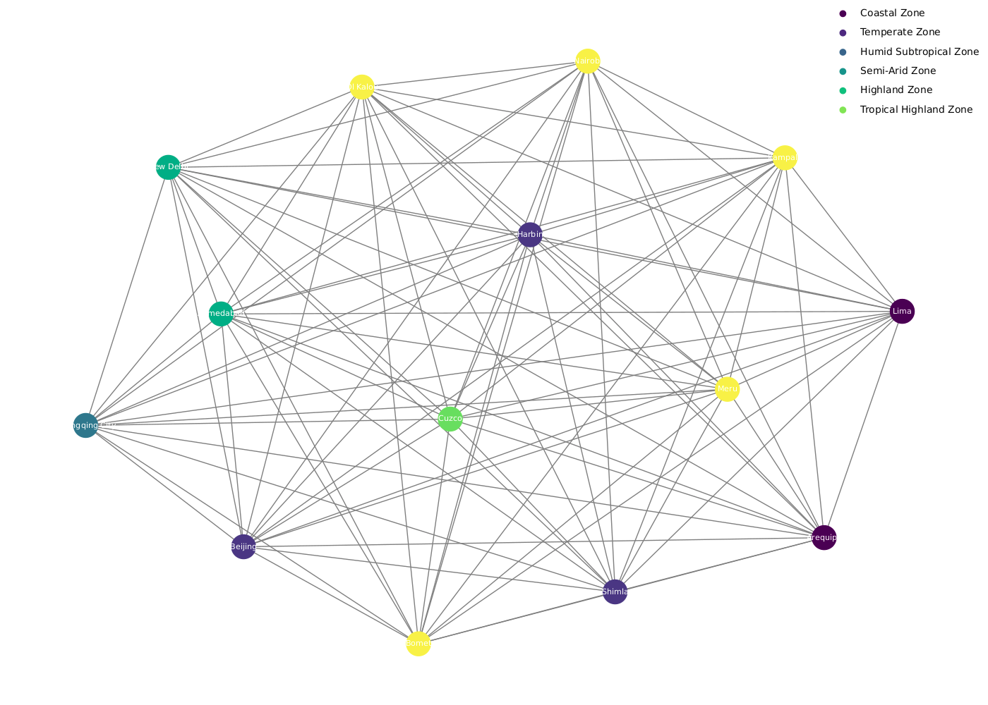

Slide 10
Disease Spread Dynamics
Node-to-Node Transmission:
When a disease-carrying vector (e.g., infected seed, human) moves from one node to another, it introduces the disease to the new region.
The impact of the introduced disease depends on the susceptibility of the host at that node.
Vector Transformation:
The risk associated with a vector can change as it moves between regions.
Factors such as distance, transportation methods, and environmental conditions can influence the transformation of the vector's risk.

Slide 11
Methodology
The epidemiological model desinged to estimate the prevalence and the spread of potato disease across potato growing regions; fcusing on the cimatic conditions favoring disease causing pathogen to proliferate in regions and the risk factor that other parameters such as trade routes, seed storage seed handling, the alternative crop that pest and pathogens could hibernate to.
All this risk factors are captured into the model whereby the collective factors in a region/designated node are encompased as a vector unit collectively ths vector unit is the risk factor of that node and the movement of seed and people from one node to another posses the risk of spread of the disease.
The disease can also be moved by animals wind direction floods and other natural phenomenas that are caused by climate change. The moment the risk vector move or transitions to another node there is some transformation in the vector risk
factor and thus making the vector to transform according to the influence of the transforming function/vector and in this case it is the vector unit of risk assocated with movement such as trade routes either passing through disease infested areas or seed being poorly handled as it is moved from one farmer to another in the market place. this vector transform the node vector that is moving and the vector that reaches the next node will be different or transformed accordingly.
Now the host node also has its risk vector and once the new vector come sin the nodes vector becomes a matrix encompassed by these two vectors

Slide 12
Key Components of the Ensemble Model
Transformer Models
Text Generation:
Utilizes fine-tuned auto-regressive transformer model (Llama-3.2-1B-Instruct).
Generates insights on potato varietal traits, genetic markers, and socio-economic dynamics.
Predicts optimal trait combinations for specific climate scenarios and disease prevalence.
Retrieval-Augmented Generation Systems (RAGs)
Incorporates real-time epidemiological data (updated daily via API).
Aligns climate and disease risks dynamically with AI-driven recommendations.
Semantic Scoring:
Fine-tuned encoder-only sentence transformer model (MPNet-based).
Classifies semantic alignment of outputs with SDGs.
Provides confidence scores for SDG alignment to track progress.
Markov Chain Models
Predicts future states of SDG targets.
Uses confidence scores from semantic scoring as inputs for continuous-time Markov chains.
Forecasts progress toward SDGs based on cropland connectivity.

Slide 13
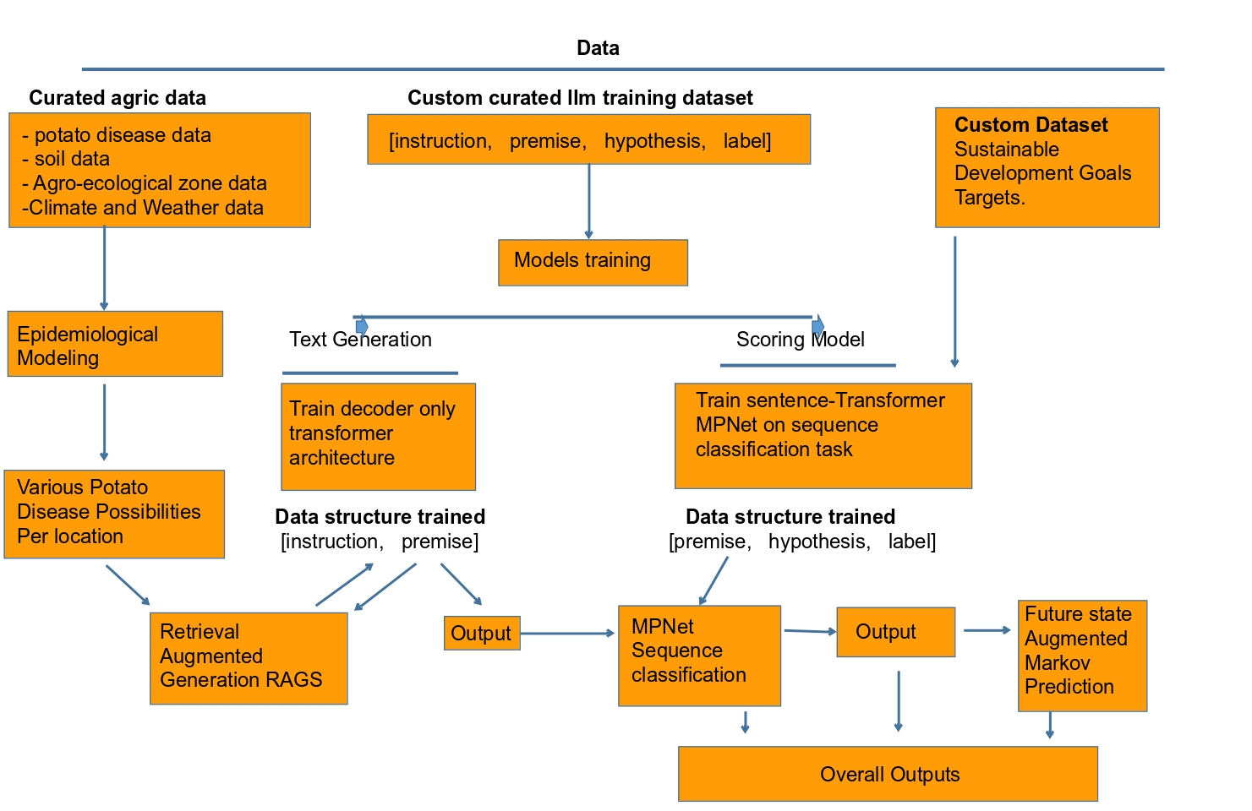

Slide 14
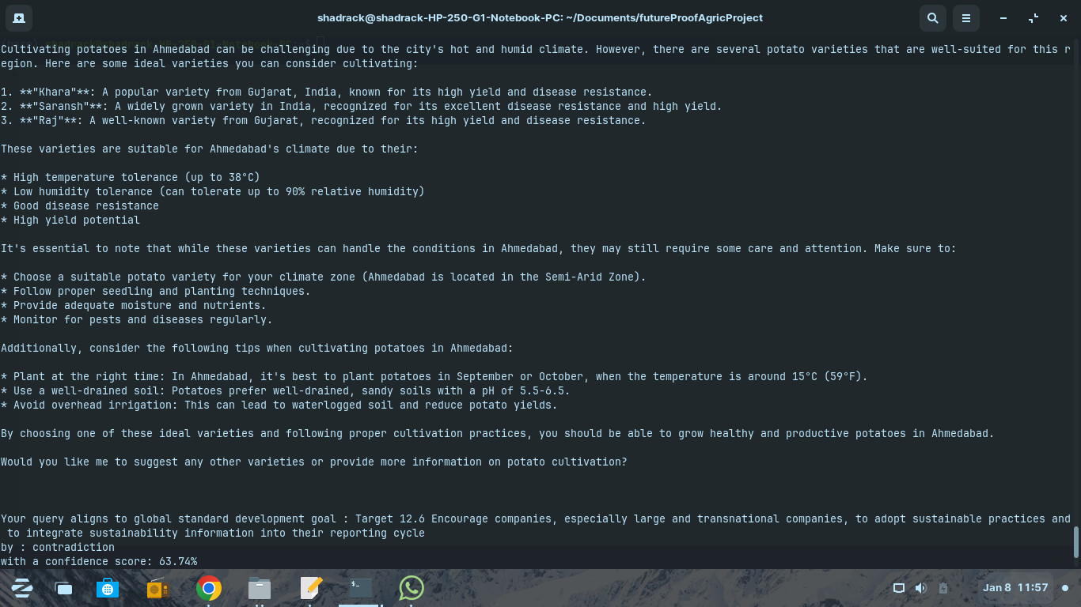
Output and Applications
Disease Risk Assessment:
Early warnings for outbreaks in potato-growing
regions of Kenya, Uganda, Peru, China, and India.
Varietal Recommendations:
Suggests resistant varieties optimized for
forecasted climatic conditions and disease risks.
SDG Alignment:
Tracks alignment with SDG 2 (Zero Hunger) and
SDG 13 (Climate Action) using semantic scoring
and Markov predictions.
Dynamic Risk Analysis:
Provides region-specific risk matrices for targeted
interventions and policy planning.

Slide 15
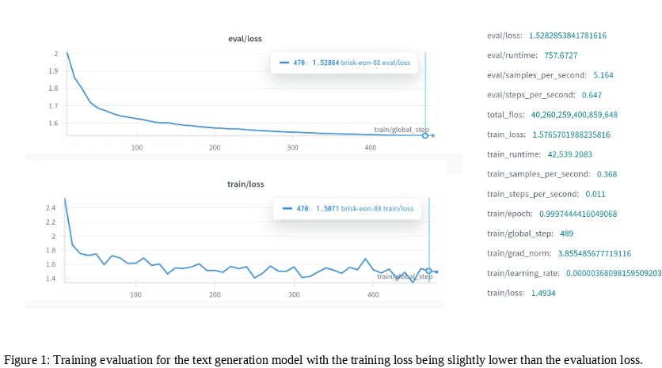
Results
Fine-tuned Potato_Wizard_v59:
Training loss: 1.49
Evaluation loss: 1.52
Operates in both offline mode for localized
insights and real-time alignment.
Facilitates actionable insights for farmers,
breeders, and policymakers.

Slide 16
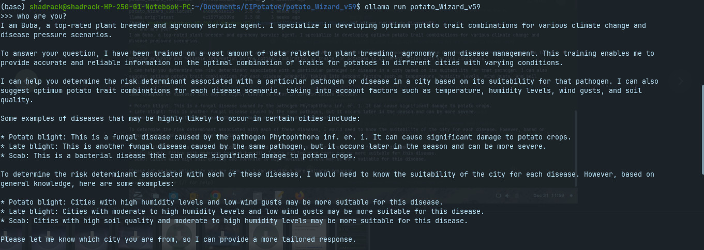

Slide 17
Thank You
To the team Shadrack Odikara and Meshack Emakunat
Our Mentors Henry Juarez, Moctar Kante and Israel Navarrete
To everyone listening
Thank You

